Slide 1

Bake My Cake
Pratyush Pande

Slide 2

Agenda
- Describing the Project Problem statement and the requirements
- Introducing the SPA
- Architecture and flow explanation
- SPA walkthrough and demo
- Future Enhancements

Slide 3
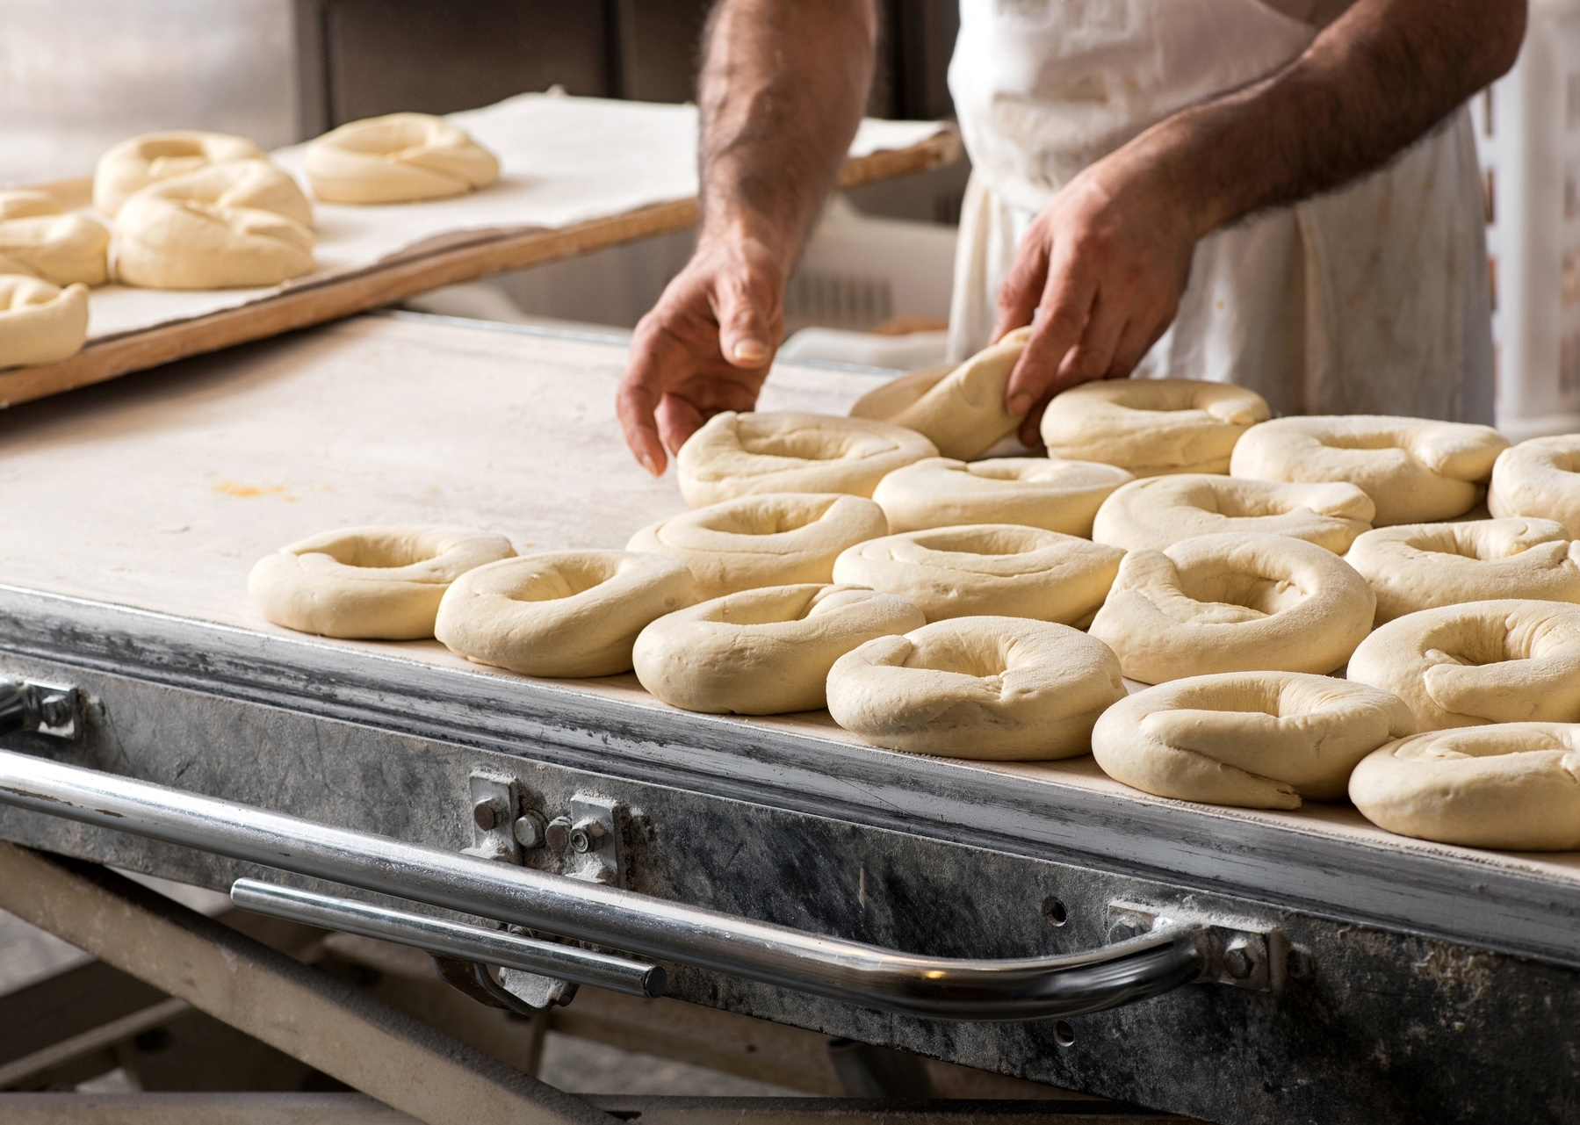

Introduction
This presentation covers the single page application project assigned to leaners as culmination of the front-end course curriculum of the Full Stack Developer program at NIIT.
This project required the learners to apply and showcase the various technologies and skills learned during the different sprints of the course.

Slide 4

Problem Statement
Bake My Cake

Slide 5

Project Requirements
Create a streamlined and user-friendly single-page application utilizing Angular, named "Bake My Cake," designed to facilitate online requests for customized cakes, cookies, or brownies.
Showcase these delectable treats through appealing images and concise details, enabling users to effortlessly choose their desired items and input order specifics.
Implement a confirmation mechanism to ensure users validate their order details before navigating away from the order view.
Incorporate a search and filtering functionality for swift item selection based on user preferences.
Additionally, enable the site administrator to access and review incoming order requests.
Implement a redirection feature prompting users to validate their identity as a site administrator before granting access to the order request view.

Slide 6
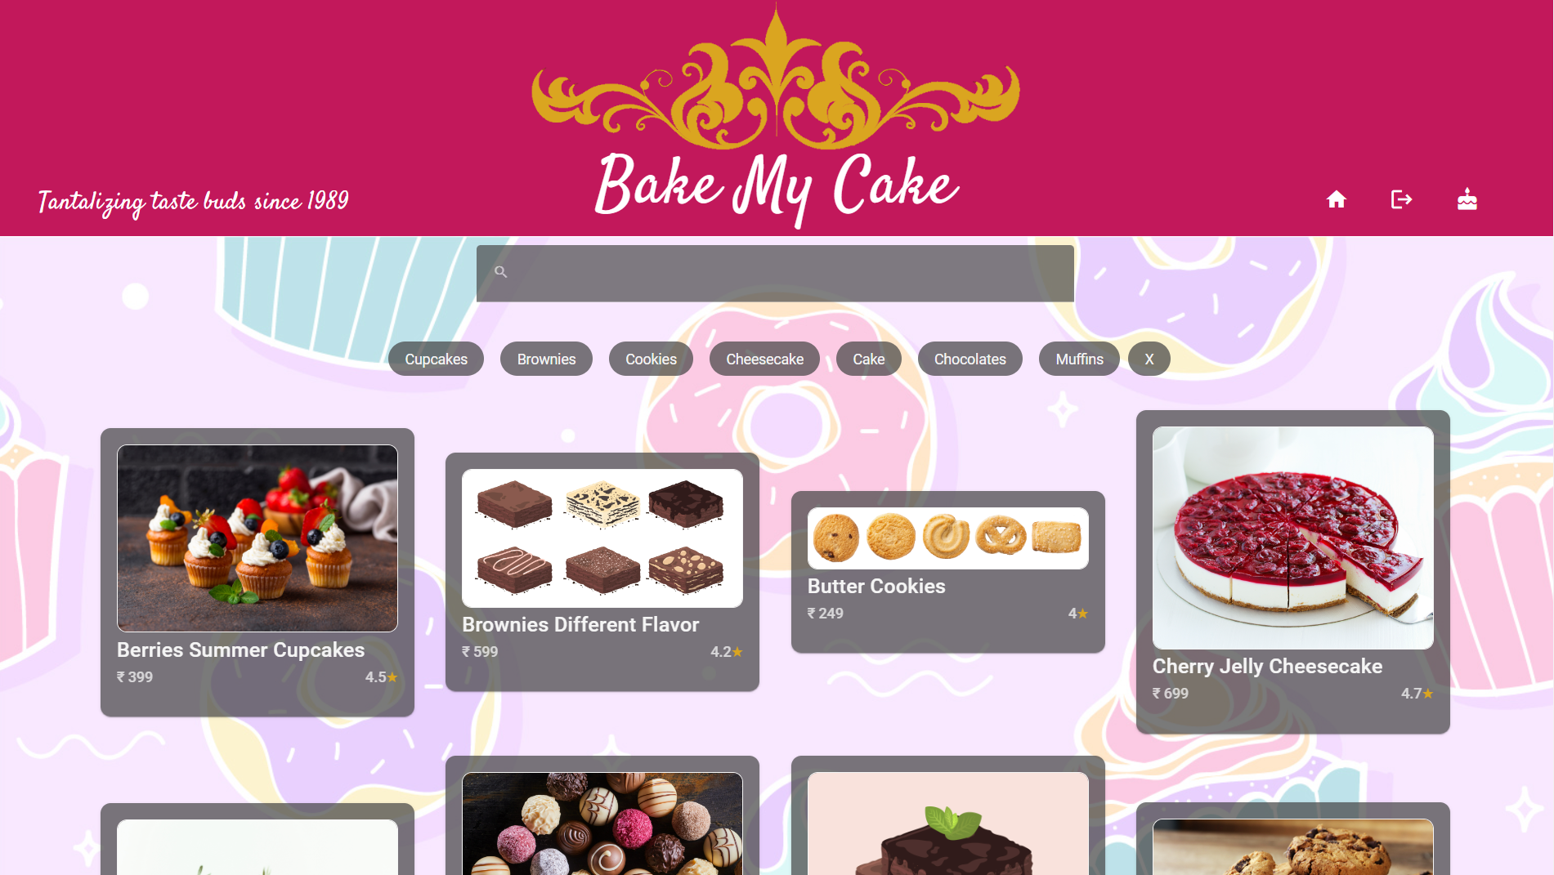
Bake My Cake

Slide 7
Technologies Used
HTML & CSS
TS & Angular Framework
Json-Server
Angular Material & Bootstrap

Slide 8
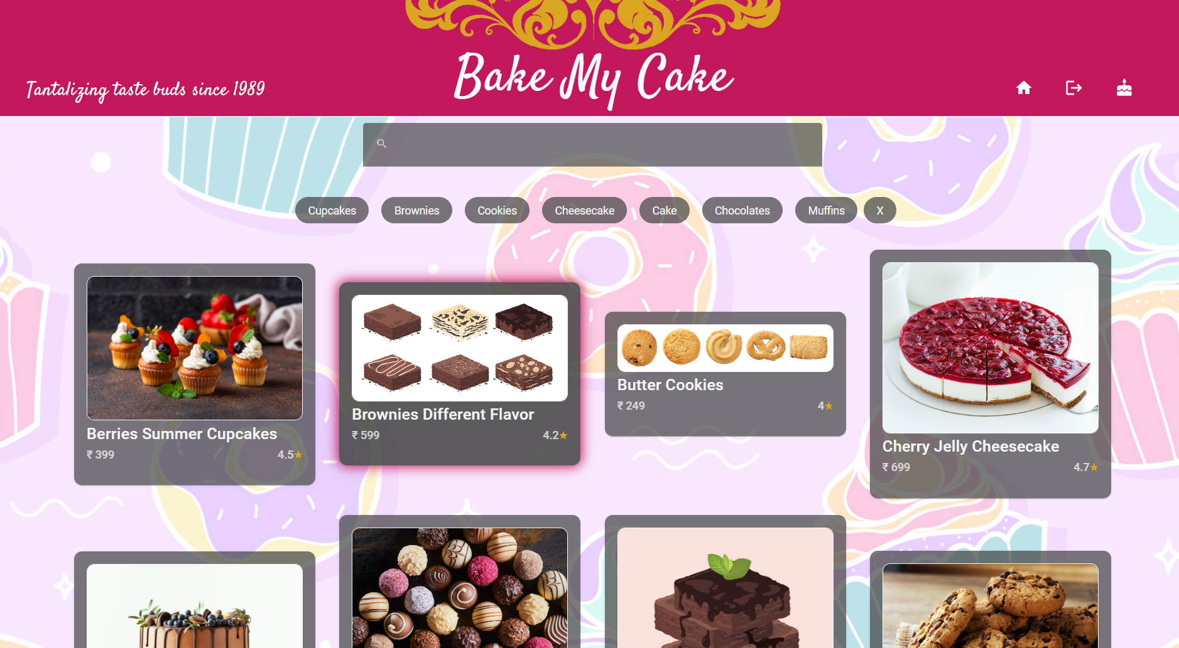
Landing View
Display images of cakes, cookies, and brownies.
Fetch data using json-server.
Set landing view as default.
Enable selection of items.
Upon selection, navigate to the order view.
Implement search by item name and filtering by category.

Slide 9
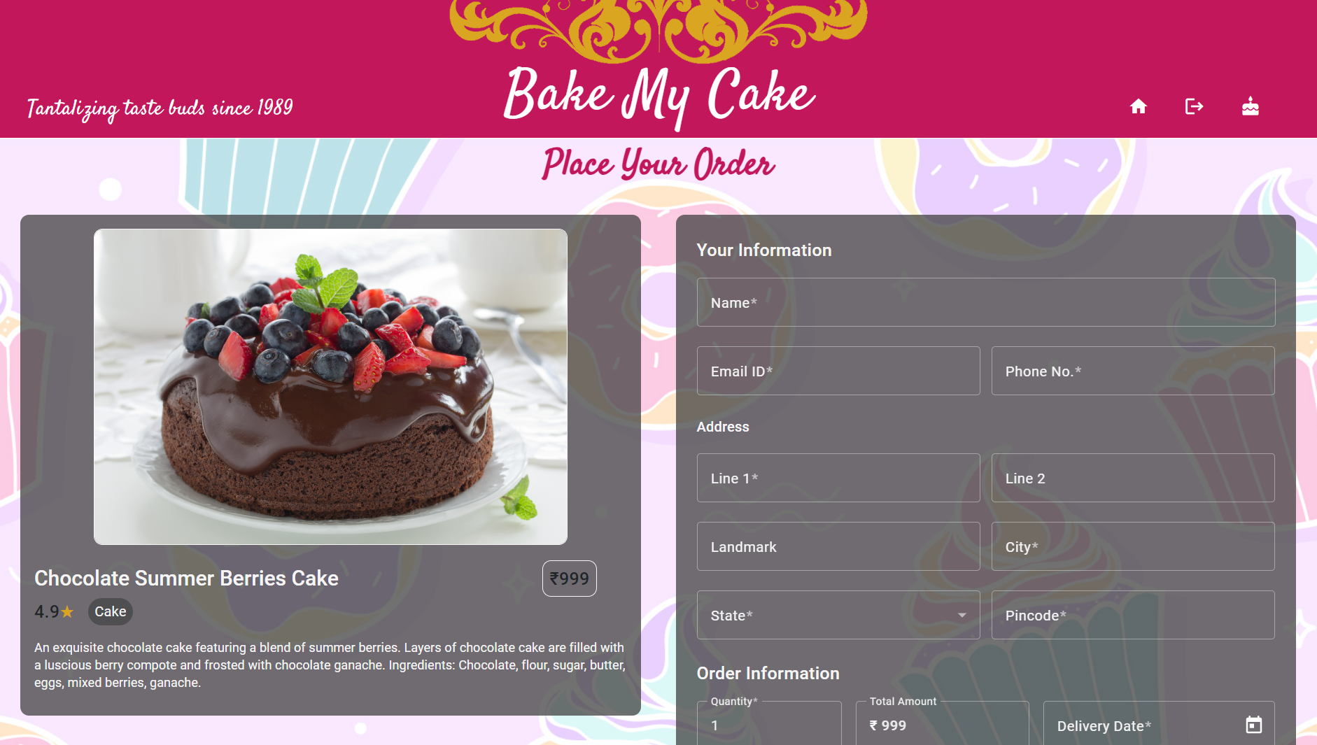
Order View
User automatically directed to order view upon item selection in landing view.
Display selected item details in the view.
Enable users to input necessary order details, including item and customer information.
Persist entered details and provide confirmation to the customer upon order placement.

Slide 10
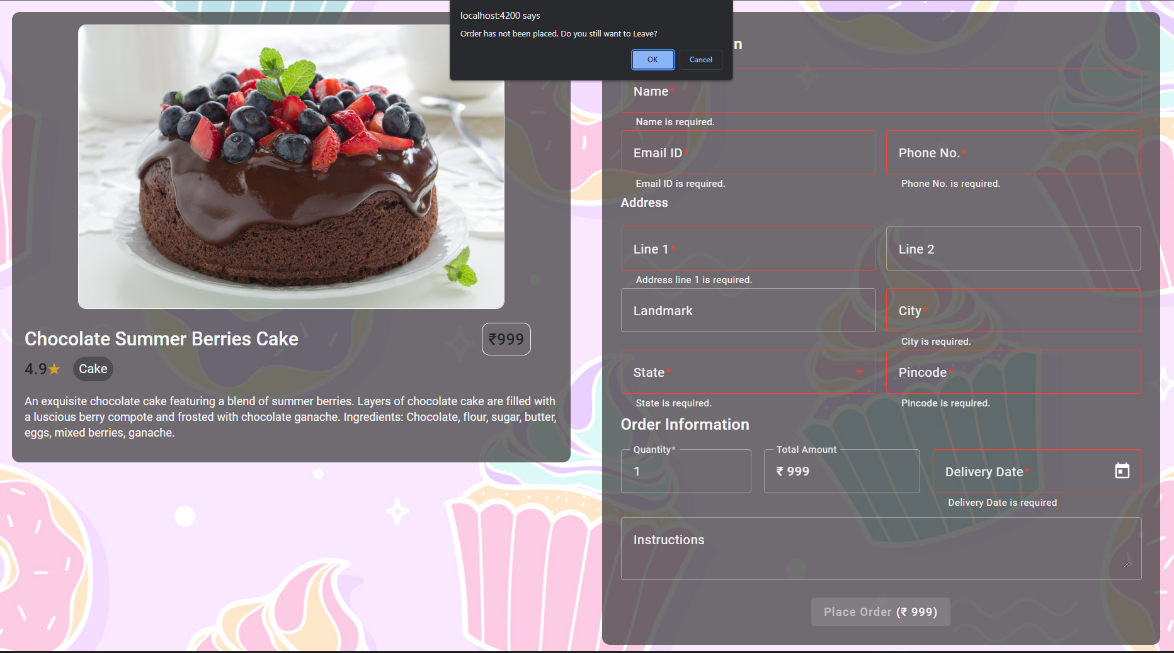
Order View - Interactions
Validation of user inputs
Confirmation from the users before allowing navigation away from view

Slide 11
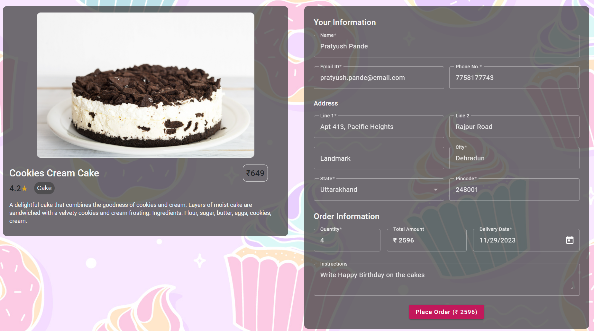
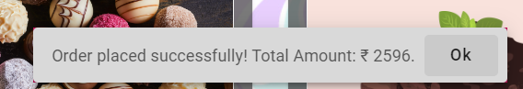
Order View - Interactions
Order placement and successful order acknowledgement prompt.

Slide 12
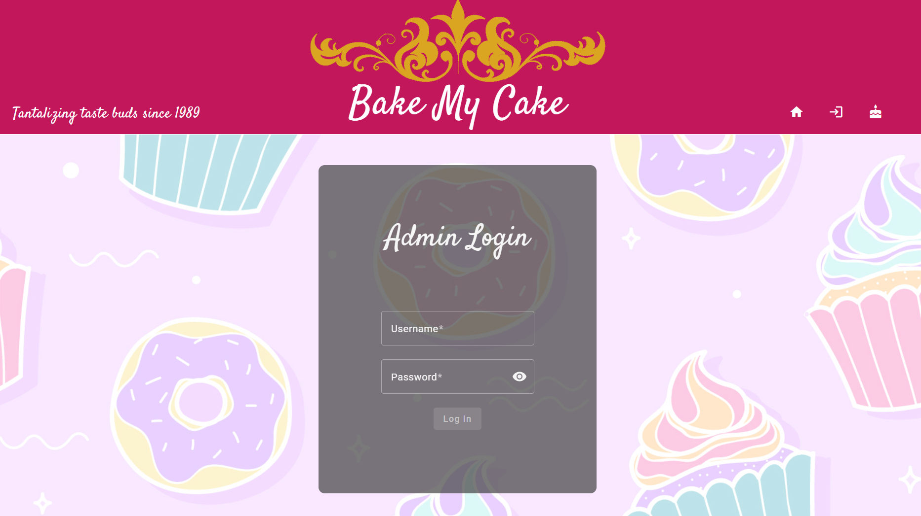
Login View
Navigation control: Redirect user to login view when attempting access to cake-requests view.
Security authentication: Prompt user to enter security code for administrator login.
Validation process: Validate entered security code.
Successful validation: Navigate user to cake-requests view.

Slide 13
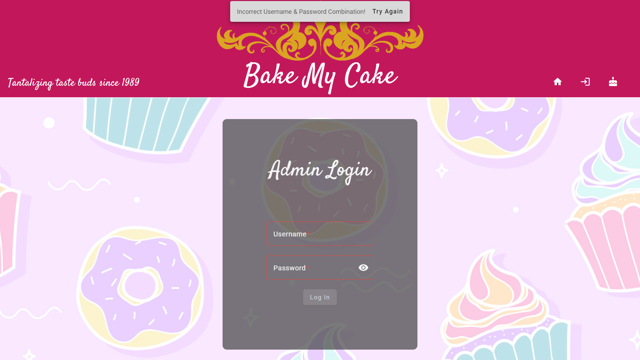
Login View - Interactions
Username and password validation and error prompt

Slide 14
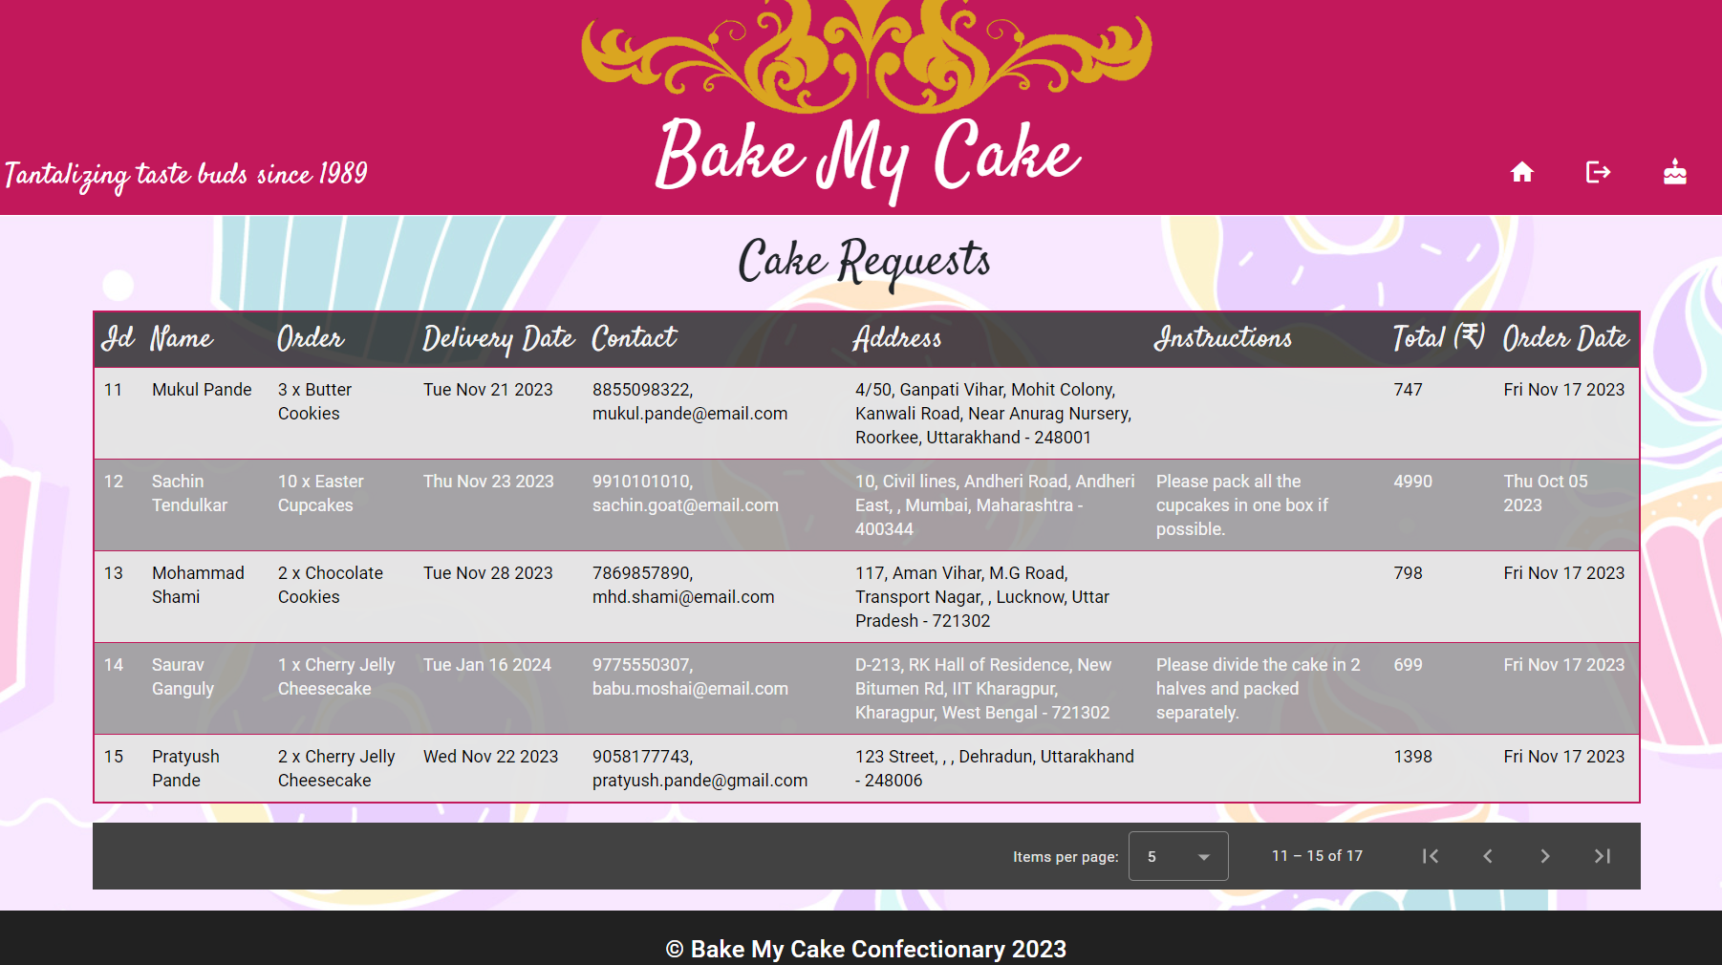
Cake-Requests View
Displays all the orders received in a tabular format.
Restricted access and is accessible only to the administrators.

Slide 15
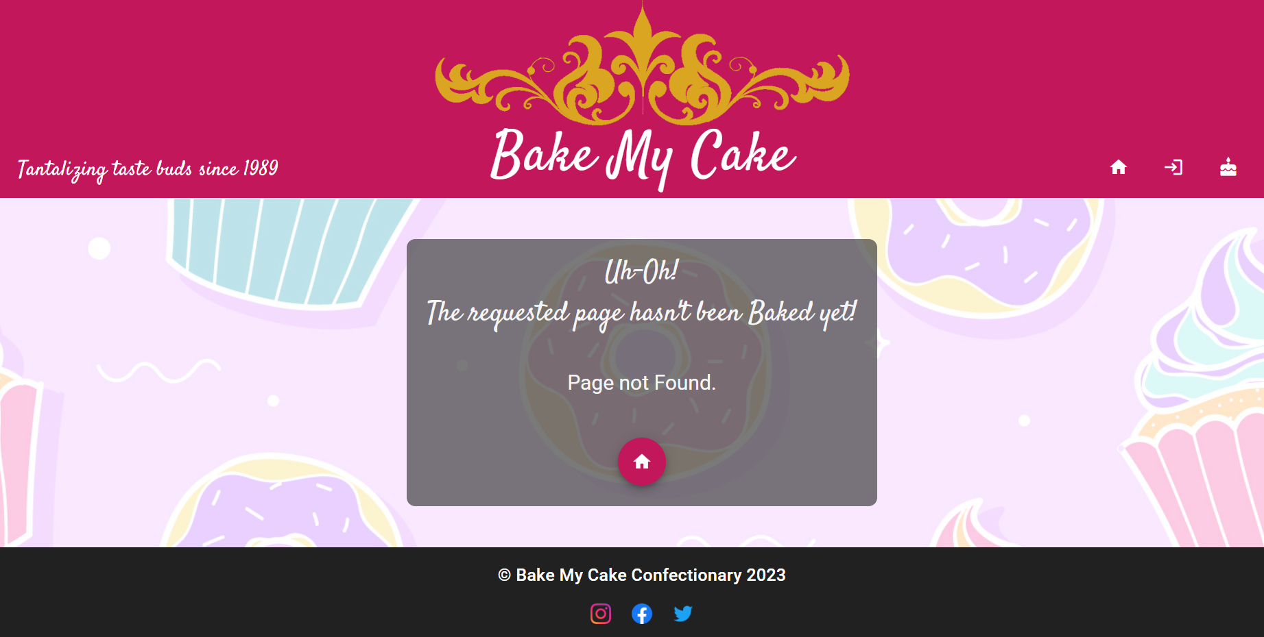
Page Not Found

Slide 16
Architecture & Flow

Slide 17
Project Components
HeaderComponent
FooterComponent
PageNotFoundComponent
LandingView Component
LoginView Component
OrderViewComponent
CakeRequestsView Component
SearchComponent
FilterComponent
ItemCardComponent
ItemDetailsComponent
OrderFormComponent
Project Services
AuthService
IndiaStatesService
ItemService
OrderService
RestErrorHandlerService
RouterService
UserService
Project Models
Project Guards
Item
Order
canDeactivateGuard
loginGuard

Slide 18

Control Flow
AppComponent
PageNotFoundComponent
navbar
links
Home
Button
getItems()
HeaderComponent
Order
placed
router-outlet
LandingViewComponent
Filter
@Output
filterEvent
Search
@Output
textChangeEvent
Item
selected
getItem(id)
Json server
FooterComponent
ActivatedRoute
ParamMap
ItemService
REST
APIs
OrderViewComponent
saveOrder(order)
OrderService
LoginViewComponent
Navigate away
Login
successful
canDeactivate
Legend
loginGuard
App linkage hierarchy
getOrders()
CakeRequestsViewComponent
User path
Data flow
Anchor links flow

Slide 19
Further Improvements
Adding mechanism to allow administrator to mark orders as done/complete
Allowing users to create accounts and save personal information to facilitate quick future check outs
Adding another page for administrators to perform CRUD operations on items on the menu
Adding cart functionality to allow the users to add different menu items to their orders
Giving users an interface to give ratings/feedback for the items

Slide 20

THANK YOU

Slide 21



Questions?

